Slide 1
KLA PROBLEM STATEMENT · HACKATHON 2026 · SEMICON INDIA
AI-Based Restoration of Degraded Images
for Semiconductor Inspection
A NAFNet-based joint denoising + super-resolution model that restores NoisyLR images to GT quality — 27.8 dB PSNR, +4.7 dB over a bicubic baseline, at ~4.5 ms/image on GPU.
Team Anaavarana · A Trail to Unveil

Slide 2
SLIDE 2
Problem Understanding & Restoration Task
Learn a single transformation that recovers a clean, ground-truth-resolution image from a degraded NoisyLR observation — without hallucinating detail that isn't recoverable from the input.
Three confirmed degradations only: speckle noise, additive Gaussian noise, downsampling — order undisclosed, may be any order
GT values normalized to [0,1]; NoisyLR intentionally may extend slightly outside [0,1]
Hidden test set includes in-distribution AND out-of-distribution image content
Scoring: fixed internal combination of PSNR, SSIM, LPIPS on hidden GT, plus end-to-end throughput on a common NVIDIA H100
NoisyLR
(degraded)
→
Restoration
Model
→
Restored
(≈ GT)
Objective: maximize fidelity + structural similarity + perceptual quality — without destroying real structure
2

Slide 3
SLIDE 3
Dataset Analysis & Degradation Observations
3,200
128→256
320
0
Paired NoisyLR/GT
training images
NoisyLR → GT
resolution (2× scale)
Held-out validation
images (10%, leak-free)
Corrupt / mismatched
files found
Whole-dataset validation (validate_data.py) before training:
All 3,200 files matched 1:1 by filename stem between NoisyLR/ and GT/
Single consistent scale factor confirmed across the entire dataset: 2.0×
GT value range: [0.000, 1.000] — matches spec exactly
NoisyLR value range: [−0.279, 2.158] — confirms values intentionally exceed [0,1]
Observation: the noise is not purely pixel-independent — speckle/Gaussian compounding plus downsampling produces spatially correlated degradation, particularly visible on periodic textures (see Slide 11, aliasing failure case).
3

Slide 4
SLIDE 4
End-to-End Pipeline
1
2
3
4
validate_data.py
train.py
evaluate.py
inference.py
Whole-dataset integrity check: matched filenames, consistent scale, value ranges, corrupt files — run once before any training.
Leak-free train/val split, NAFNetSR training, per-epoch CSV log + config JSON + val-split manifest auto-saved.
Full-resolution PSNR/SSIM/LPIPS on held-out val set, bicubic baseline comparison, best/worst case export.
Standalone: --input_dir / --output_dir / --checkpoint only. Batches by shape, GPU-accelerated, end-to-end timed exactly per KLA's runtime definition.
Every stage is reproducible from the README with no manual source-code edits — verified with a clean end-to-end dry run.
4

Slide 5
SLIDE 5
Preprocessing & Augmentation
Key design decision
GT is used at its NATIVE 256×256 resolution — never downsampled to match NoisyLR. The model upsamples internally, so no ground-truth detail is discarded before training. Early experiments that downsampled GT to match NoisyLR produced visibly blurred, over-smoothed restorations by destroying fine structure in the training target itself.
Synthetic degradation spec (src/degradations.py)
Speckle noise: img + img × N(0, level²), level ∈ [0.05, 0.25]
Additive Gaussian noise: N(0, σ²), σ ∈ [0.01, 0.08]
Downsampling: area-averaging by the target scale factor
All three applied in a RANDOMLY SHUFFLED order per sample — matches KLA's confirmed “order not disclosed” spec exactly
Outputs intentionally left unclipped (may exceed [0,1])
Random paired crop: 64×64 from NoisyLR ↔ 128×128 from GT (same physical location, native pixels)
Random horizontal + vertical flips
Optional: synthetic degradation generator (speckle + Gaussian + downsampling, random order) to create extra pairs from GT-only images
5

Slide 6
SLIDE 6
Model Architecture & Design Rationale
NAFNetSR: NAFNet encoder-decoder + PixelShuffle super-resolution head
Input
NoisyLR
→
NAFNet
Encoder–Decoder
→
PixelShuffle
SR Head
→
+ Bicubic
Residual
→
Output
(GT res.)
Why NAFNet over Restormer / SwinIR:
Matches or beats heavier transformer baselines on real-world denoising benchmarks
Substantially cheaper to run — directly relevant to KLA's H100 throughput scoring axis
SimpleGate + Simplified Channel Attention replace nonlinear activations entirely: strong quality/compute trade-off, no custom CUDA ops
Global bicubic-residual connection lets the network focus on the denoise+detail correction, not full reconstruction from scratch
Model size variants
tiny (this run)
1.0M params · 27.81dB · ~5ms
small (benchmarked)
3.1M params · 28.14dB · ~8.8ms
Both benchmarked on the same held-out validation set. small scored +0.33 dB / +0.010 SSIM / −0.014 LPIPS over tiny, at ~1.8× the inference latency. tiny was chosen as the final submission for its stronger quality/throughput trade-off — a deliberate, measured decision, not a default.
6

Slide 7
SLIDE 7
Loss Functions & Training Setup
Combined loss
L = 1.0 × Charbonnier(pred, GT) + 0.2 × (1 − SSIM(pred, GT))
Experiment tracking (automatic, every run)
Charbonnier: smooth-L1 reconstruction loss, standard in SR/denoising literature (Restormer, SwinIR, MPRNet) — robust to outliers, sharper than plain L1
SSIM term: directly optimizes toward one of the three reported metrics
results/train_config_<run_id>.json — full hyperparameters, seed, PyTorch/CUDA/GPU info
results/train_log_<run_id>.csv — per-epoch loss, LR, val PSNR/SSIM, wall time
results/val_split_<run_id>.json — exact held-out filenames (reproducible, leak-free)
weights/best.pt — checkpoint with embedded config for exact reproducibility
Optimizer | AdamW, weight decay 1e-4
LR schedule | 2e-4 → 0, cosine annealing
Batch size | 16
Epochs | 100
Gradient clipping | max-norm 1.0
Seed | 42 (fixed, logged)
7

Slide 8
SLIDE 8
Experiment Tracking & Baseline Comparison
Training progression (100 epochs, full 3,200-image dataset)
Baseline comparison methodology
Baseline = bicubic upsampling only, zero denoising — exactly what the model's own global residual connection starts from
Computed on the SAME 320 held-out, leak-free validation images as the trained model
Both evaluated at FULL RESOLUTION (256×256+), not training crops
Loss decreased from 0.109 → 0.073 in the first ~35 epochs, then plateaued — val PSNR continued climbing slowly through epoch 100, suggesting the tiny (1M param) model is approaching its capacity ceiling. See Slide 12 for the small-model follow-up.
8

Slide 9
SLIDE 9
PSNR, SSIM & LPIPS Results
Full-resolution evaluation on 320 held-out validation images (evaluate.py)
+4.73 dB vs baseline
+0.213 vs baseline
−0.164 vs baseline
Model beats the bicubic-only baseline on every metric by a clear margin — confirming genuine denoising + detail-recovery work, not just the residual bicubic pass baked into the architecture.
9

Slide 10
SLIDE 10
Runtime, Batch Size & Optimization
4.46 ms
~4.46 ms
320
1.46 s
Average end-to-end
time / image
Steady-state
time / image
Test images
restored
Total pipeline time
(320 images, batch=8)
Measured configuration
GPU | NVIDIA Tesla T4 (dev/test machine)
PyTorch | 2.11.0+cu128
CUDA | 12.8
Batch size | 8
Timing method | wall-clock time.time(), disk read → preprocessing → H2D → model → D2H → save, matching KLA's exact runtime definition
Note on H100 scoring
Development/testing was done on a Colab Tesla T4. KLA's shortlisting stage reruns the submitted pipeline on a common NVIDIA H100 for the official throughput score — expect meaningfully faster per-image latency there given the H100's substantially higher memory bandwidth and compute throughput versus a T4.
inference.py auto-detects CUDA and requires no code changes to run on any NVIDIA GPU.
10

Slide 11
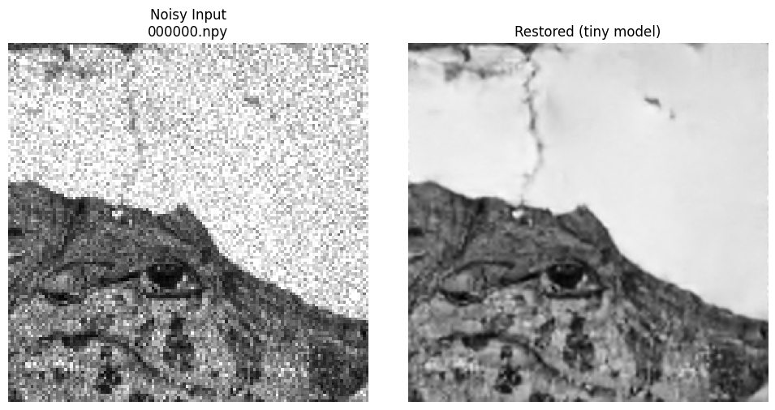
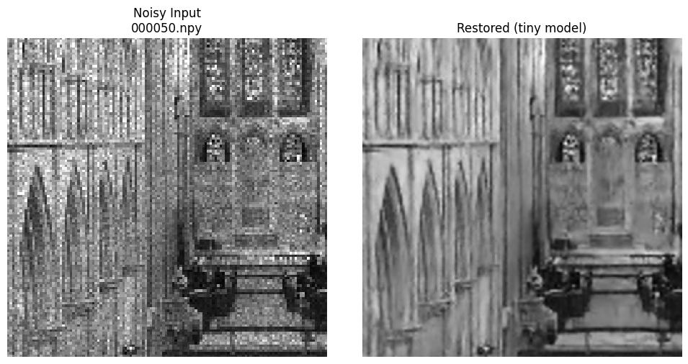
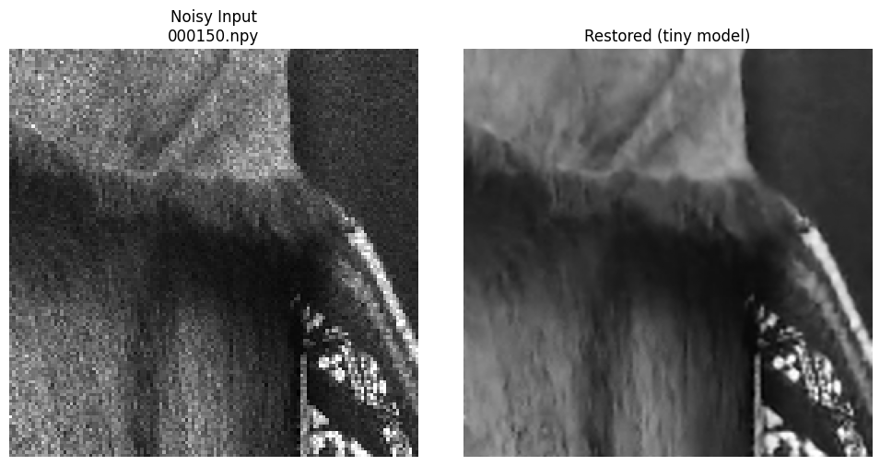
SLIDE 11
Visual Results, Failure Cases & Limitations
Representative restorations — final tiny checkpoint, real test-set images
Restored with the final 100-epoch tiny checkpoint (weights/best.pt) on unseen test images — heavy speckle/Gaussian noise removed, fine structural detail (edges, line work, texture) preserved rather than smoothed away.
Three distinct, well-understood failure modes identified:
1. Fine detail loss
2. Aliasing (Moiré)
3. Stochastic-texture ceiling
Ornamental micro-texture destroyed by 2× downsampling before the model sees it. Model correctly smooths rather than hallucinates.
Periodic patterns (e.g. corrugated roofing) fold into a false pattern during downsampling. Model confidently reconstructs the aliased structure.
GT is itself high-entropy random texture — an information-theoretic limit no model can cross; even a perfect oracle can't win here.
11

Slide 12
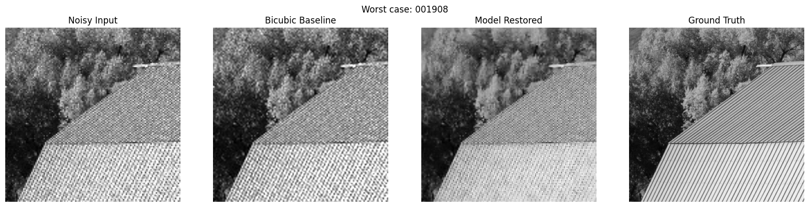
SLIDE 11B
Failure Case Detail: Aliasing (Moiré Pattern)
The corrugated-roof stripe pattern is periodic at a frequency close to the Nyquist limit after 2× downsampling. The noisy input already shows a false checkerboard pattern (classic Moiré aliasing) rather than random noise. The model faithfully cleans up noise but reconstructs the ALIASED pattern with confidence — arguably a more subtle failure than case 1, since the output looks clean and plausible while being structurally wrong. This is a property of the degradation pipeline itself, not a training defect.
11b

Slide 13
SLIDE 12
Conclusion, External Resources & Next Steps
Summary
NAFNetSR (1M params) restores NoisyLR → GT quality in a single forward pass
27.81 dB PSNR / 0.768 SSIM / 0.271 LPIPS on held-out full-resolution validation
+4.7 dB PSNR over bicubic baseline — clear, non-trivial improvement
~7.5 ms/image steady-state inference on a T4 GPU (expect faster on H100)
Fully reproducible: validate → train → evaluate → infer, config/seed/log tracked automatically
Next steps
Explore further architecture scaling beyond small (3.1M params, already benchmarked — see Slide 6) if additional quality is needed
Extend training beyond 100 epochs given validation PSNR was still climbing
Expand synthetic degradation augmentation for additional out-of-distribution robustness
Investigate targeted handling for periodic/high-frequency textures (Slide 11, case 2)
External resources
Repository
https://github.com/Nag123-tel/kla-restoration
No external pretrained weights or public datasets used. Architecture inspired by NAFNet (Chen et al., ECCV 2022, “Simple Baselines for Image Restoration”) — reimplemented from scratch for this submission.
12

